Slide 1
The design of OPQ
levin.lin@ringcentral.com

Slide 2
Outline
What is OPQ
Why do I design OPQ
How do I design OPQ
What is the progress of OPQ

Slide 3
What is OPQ
Open persistent message queue
  Open source
  Persistent storage of messages
  Message queue
Othter open message queues
  RabbitMQ
  ZeroMQ
  Kafka
  …

Slide 4
Why do I design OPQ
An ideal message queue should be as easy to use as simply calling an API – levin.lin:-p
  No additional client required
  Language independent
An ideal message should enable message replay
An ideal message should be born for high performance
  Able to handle message as many as possible

Slide 5
How do I design OPQ - Goal
Easy to use
High performance
Operations-friendly (to do)

Slide 6
How do I design OPQ
– Easy to use
http://path/to/opq
HTTP POST
  Header
  Body – {target url, topic, message}

Slide 7
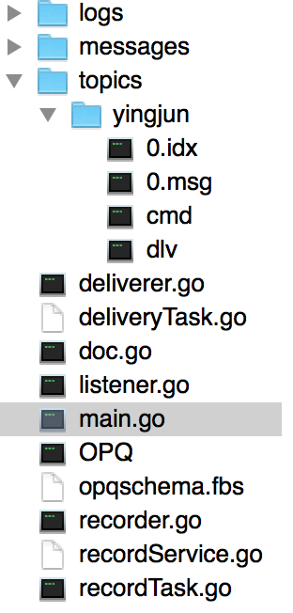
How do I design OPQ
– overview
Code hierarchy

Slide 8
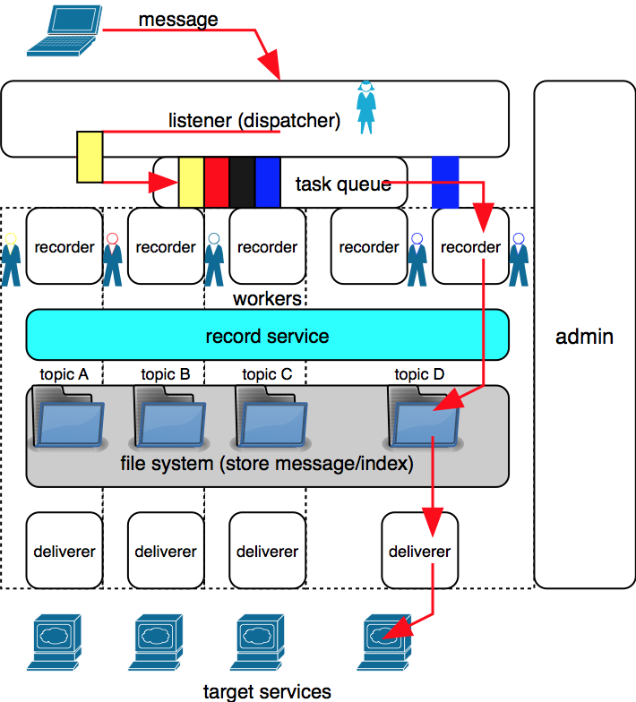

Slide 9

How do I design OPQ
– High performance
implemented by GO
  C like language
  Easy to use
  Born for high concurrency
efficient read&write
  Group submit – buffered write
  Small index file – sparse index
  Memory map – mmap
  Reduce IO – binary than linear search

Slide 10
How do I design OPQ
– High performance
efficient serialization
  FlatbBuffers
full use of CPUs
  Groutine based dispatcher/workers model
efficient IPC
  Go channel based process communication – notification rather than shared memory
  Lock free

Slide 11
How do I design OPQ
– High performance
FlatBuffers
  What we care about when considering Serialization
    Human readable (schema free/interpreted or not) – JSON/XML vs FlatBuffers/Protocol Buffers
    Runtime efficiency (random accessible/parsing and unpacking needed or not) – JSON/XML/Protocol Buffers vs FlatBuffers
    Memory efficiency (additional memory allocation needed or not) – Protocol Buffers vs FlatBuffers
    Tiny code footprint (large amount of generated code need or not) JSON in statically typed languages/Protocol Buffers vs FlatBuffers
  FlatBuffers aims at memory/performance critical application/platform (like mobile hardware)
  FlatBuffers wins! (Benchmarks)

Slide 12
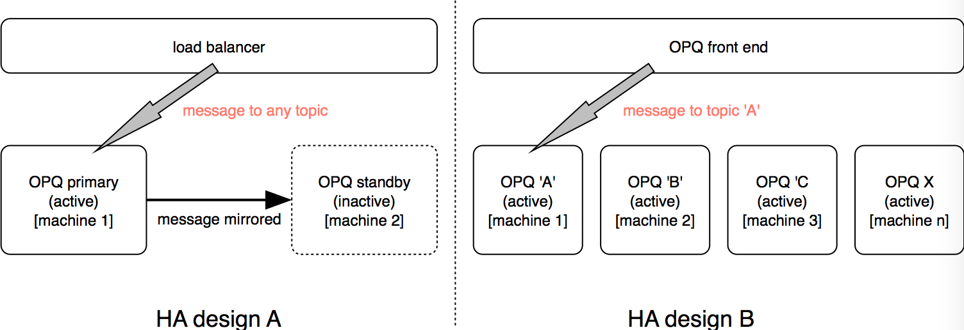
How do I design OPQ
– operations-friendly(todo)

Slide 13
What is the progress
In Progress
  Entire framework
  Message storage
  Message delivery
To Do
  Detailed change/improvement
  High Ability Assurance
  Admin portal
  Full tests/Banchmark
  Open source

